Slide 1



Slide 2
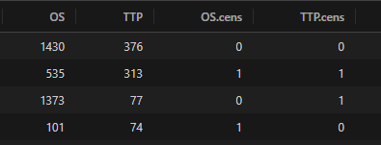

Slide 3
Progression
Progression
Censored
at t=1373
t=535
t=77
t=313
Basal state
Death
Basal state
Death
Censored at t=313
Censored at t=77
Patient 2
Patient 3

Slide 4
Progression
t=313
t=535
Basal state
Death
Censored at t=313
Patient 2
Progression
Progression
Censored
at t=376
Censored
at t=1373
t=77
Basal state
Death
Basal state
Death
Censored at t=376
Censored at t=77
Patient 1
Patient 3

Slide 6
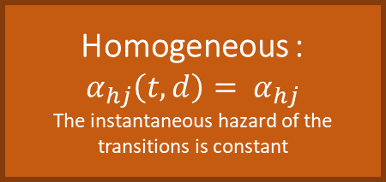
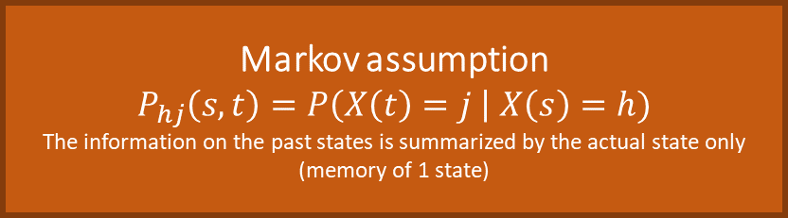
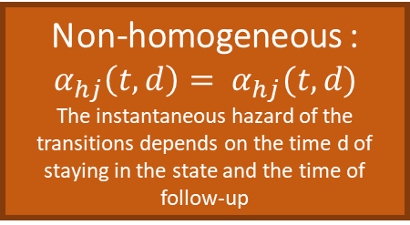
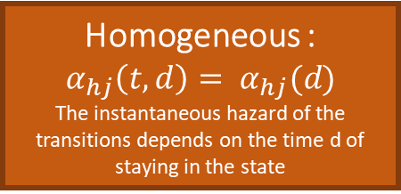
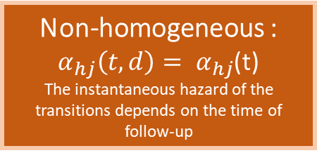
General notation of estimators
based on counting process
Simplification
Markov assumption
$$P_{hj}\left(s,t\right)=P\left(X\left(t\right)=j \right| X\left(s\right)=h)$$
The information on the past states is summarized by the actual state only (memory of 1 state)
Semi-markov assumption
The information on the past states is summarized by the actual state AND the time of staying in the state
Homogeneous :
$$α_{hj}\left(t,d\right)= α_{hj}$$
The instantaneous hazard of the transitions is constant
Non-homogeneous :
$α_{hj}\left(t,d\right)= α_{hj}$(t)
The instantaneous hazard of the transitions depends on the time of follow-up
Homogeneous :
$$α_{hj}\left(t,d\right)= α_{hj}(d)$$
The instantaneous hazard of the transitions depends on the time d of staying in the state
Non-homogeneous :
$$α_{hj}\left(t,d\right)= α_{hj}(t,d)$$
The instantaneous hazard of the transitions depends on the time d of staying in the state and the time of follow-up
Complexity

Slide 7



Progression
$$p_{12}$$
$$p_{11}$$
Basal state
Death
$$p_{13}$$

Slide 8


$$p_{22}$$
Progression
$$p_{23}$$
Basal state
Death

Slide 9

Progression
$$p_{33}$$
Basal state
Death

Slide 10
Progression
Treatment 2 : Diminution of 46 % of having a progression
Treatment 2 :
No statistical difference (HR≈1)
Basal state
Death
Treatment 2 :
No statistical difference (HR≈1)

Slide 11
Basal state
Progression or Death
Treatment 2 :
Diminution of 42 % of having a progression
Basal state
Death
Treatment 2 :
No statistical differences

Slide 12
PFS
Basal state
Death/Progression
OS
Basal state
Death

Slide 13










$$p_{ij}$$
$$p_{jk}$$
$$J_{n−1}=i$$
$$J_{n}=j$$
$$J_{n+1}=k$$
$$S_{n+1}$$
times
$$S_{n−1}$$
$$S_{n}$$
$$X_{n}=S_{n}−S_{n−1}$$
$$X_{n+1}=S_{n+1}−S_{n}$$

